Slide 1
Real Estate Market Analysis

Slide 2
Contents
Data Collection
Exploratory Data Analysis
Predictive Analysis

Slide 3

Tools and Packages

Slide 4
Data Collection

Slide 5
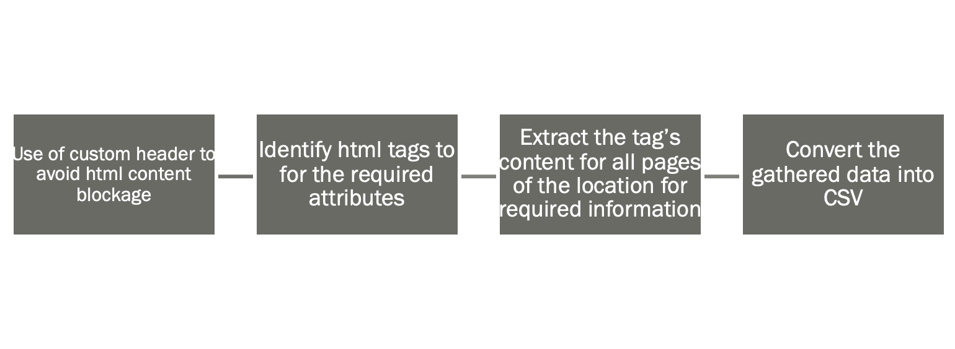
HTML parser
Data source: Redfin
Redfin is a real estate brokerage company based in Seattle, Washington, that provides online real estate services to homebuyers and sellers.
• Address attributes • House Attributes • Price attributes
An HTML parser reads the HTML code and parses it into a structured format that can be processed by other programs or displayed in a web browser.

Slide 6
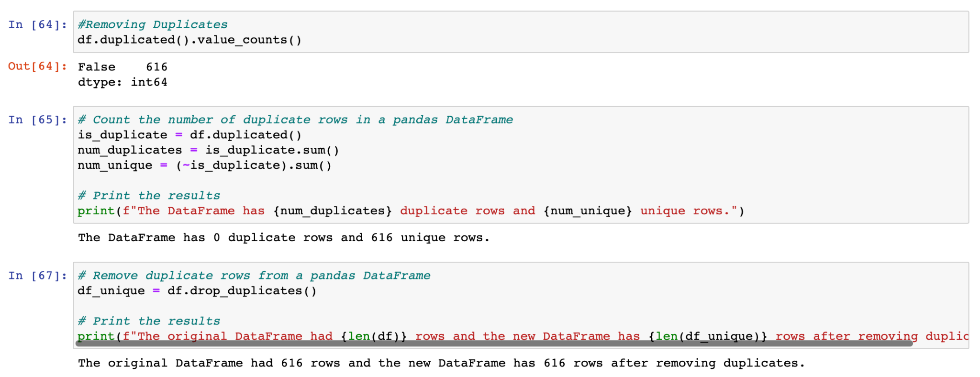
Steps for Data Cleaning
Removing duplicates: Duplicate records can cause errors in analysis, so it's important to remove any duplicate records from the dataset.

Slide 7
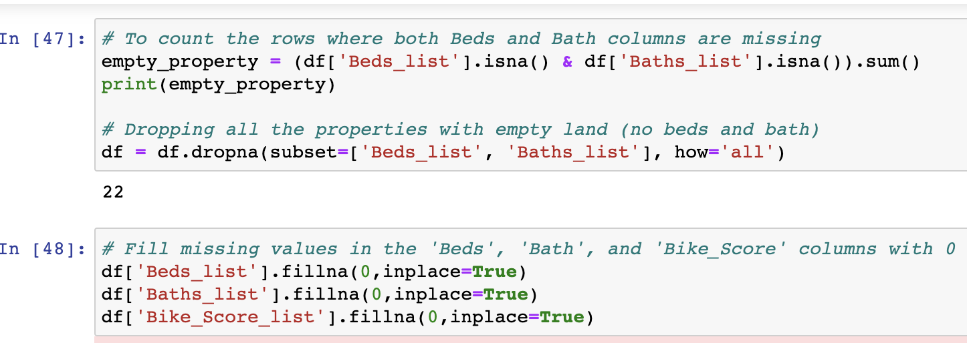
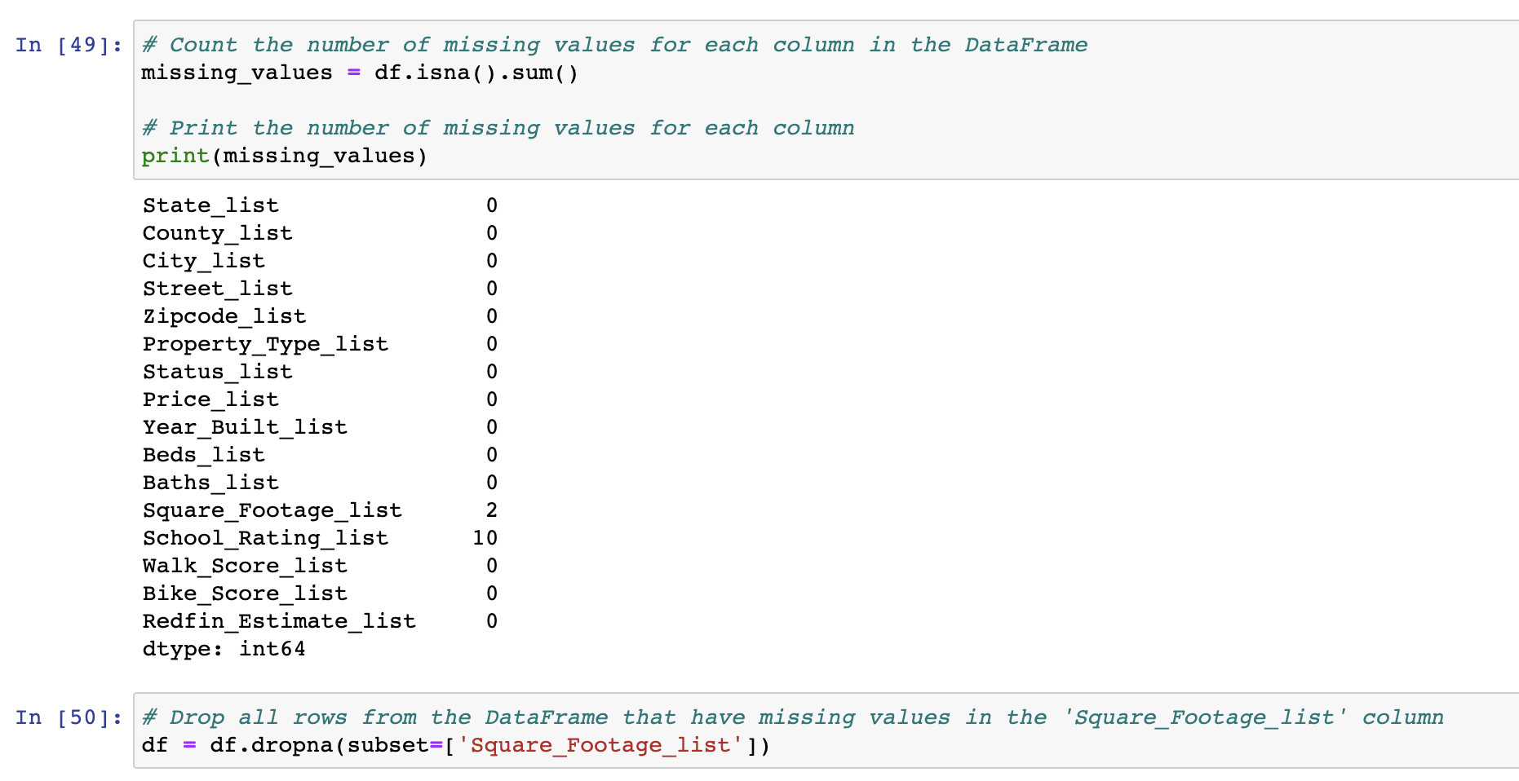
Steps for Data Cleaning
Handling missing data: Missing data can be handled in a variety of ways, such as imputing the missing values or removing the records with missing values.So we have to fill the missing data

Slide 8
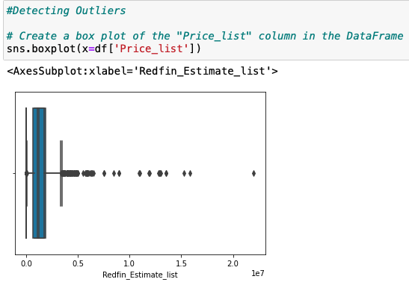
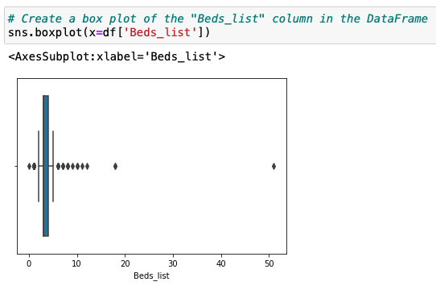
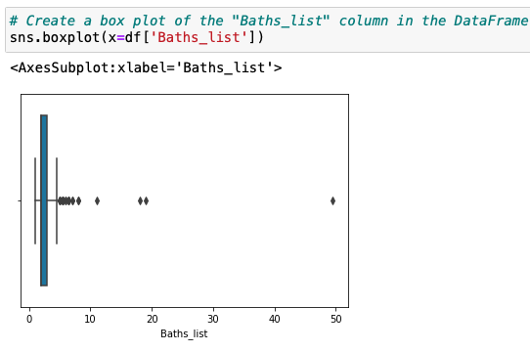
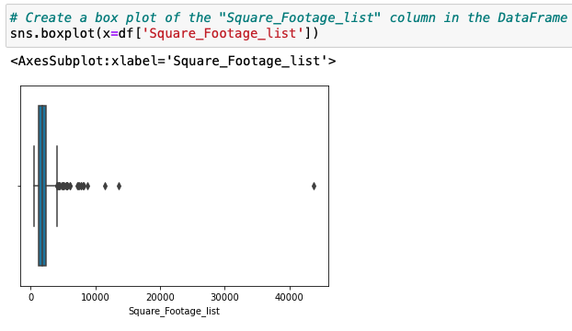
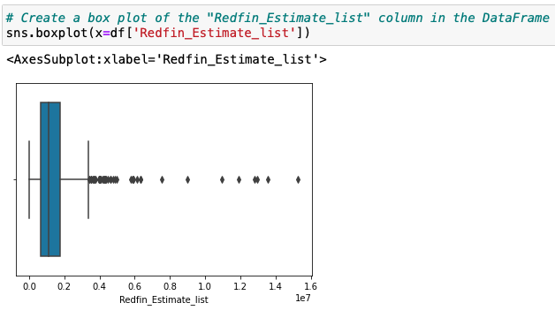
Handling outliers: Outliers can be identified and removed, or they can be corrected or imputed using statistical methods.

Slide 9
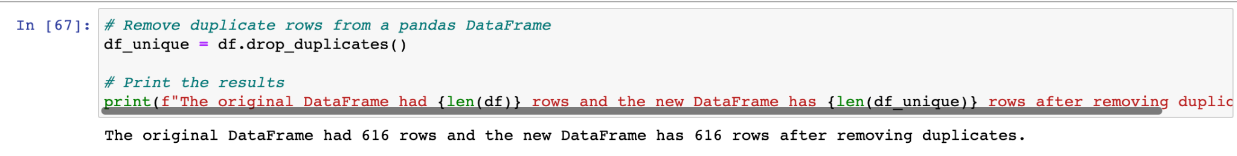
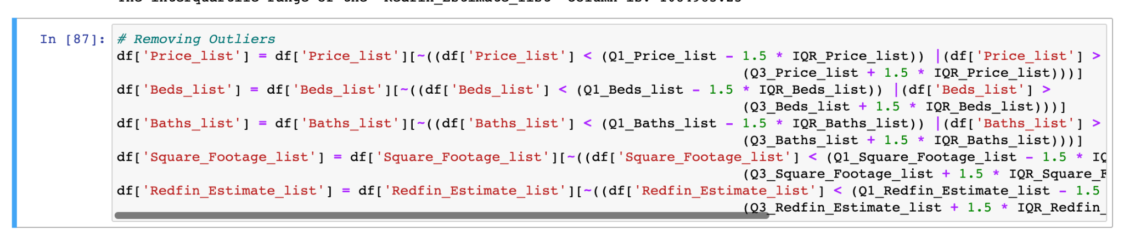
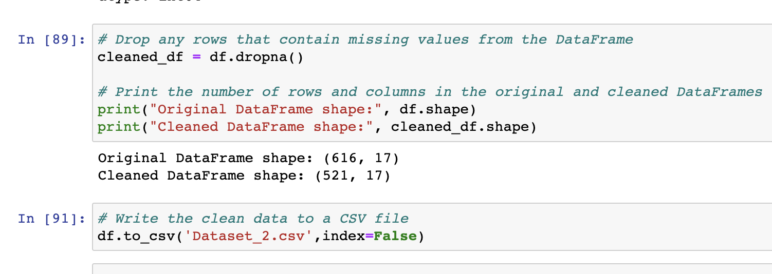
Validating data: Finally, the cleaned data should be validated to ensure that it is accurate and ready for analysis.

Slide 10
Exploratory Data Analysis

Slide 11
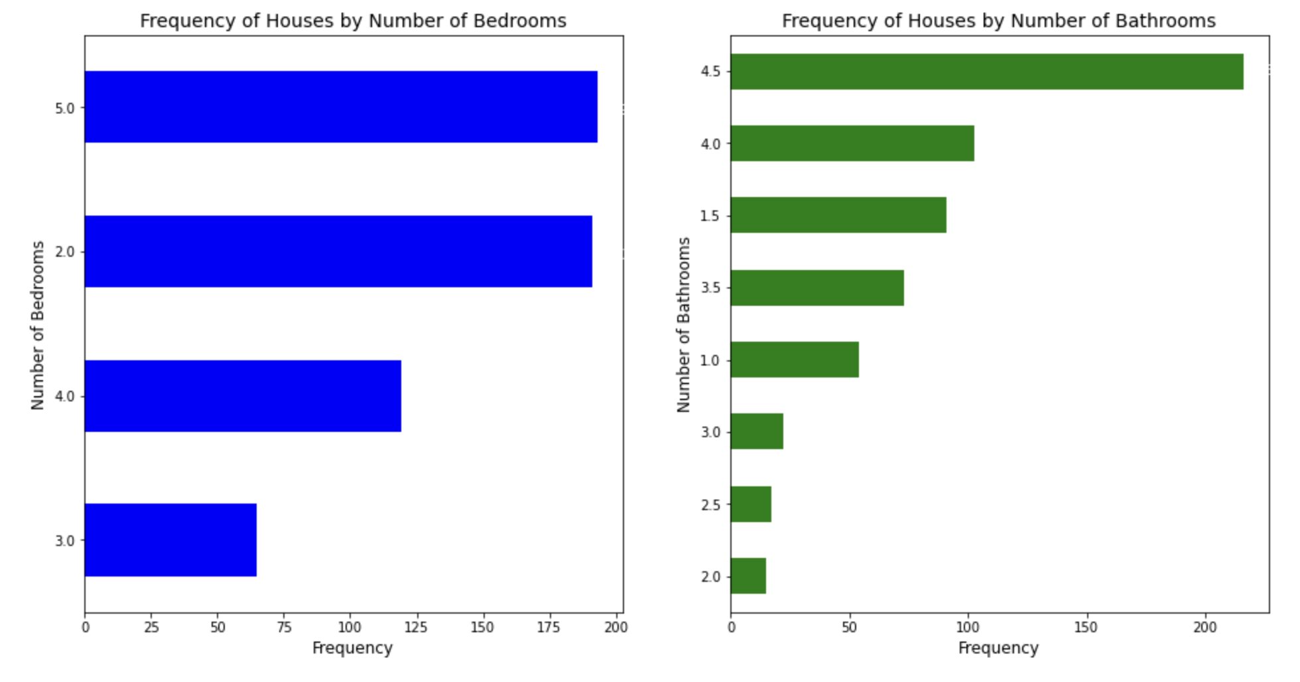
Classification of Houses based on number of Beds and Baths
We can see from bar plot that most of the houses have either 2 or 5 bedrooms
We can also find that most of the houses have 4.5 bathrooms
4 and 1.5 bathroom houses have a decent share.

Slide 12
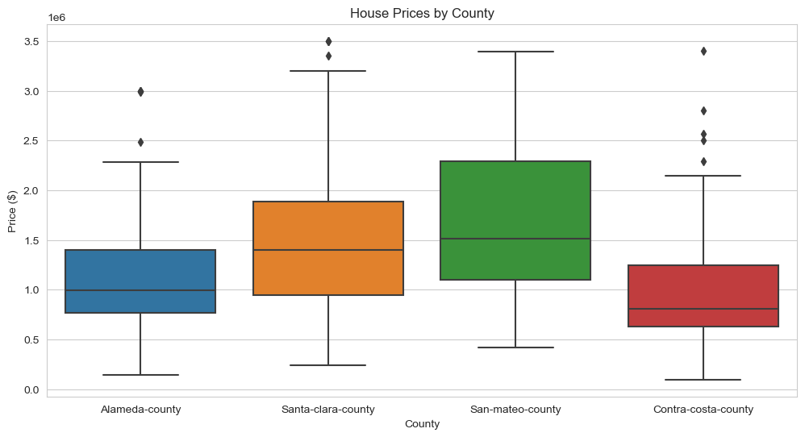
House prices based on County
San Mateo County has most of the houses with higher price compared to other counties
Contra Costa County has most of the houses with least price but it has some houses which are much costlier.

Slide 13
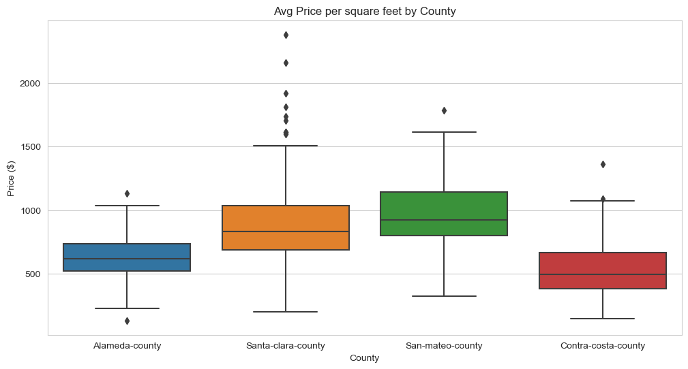
Average price per sq. ft by county
Santa Clara County and San Mateo County has higher price per sq. ft.
Some houses in Santa Clara County have a very high price per sq. ft.

Slide 14
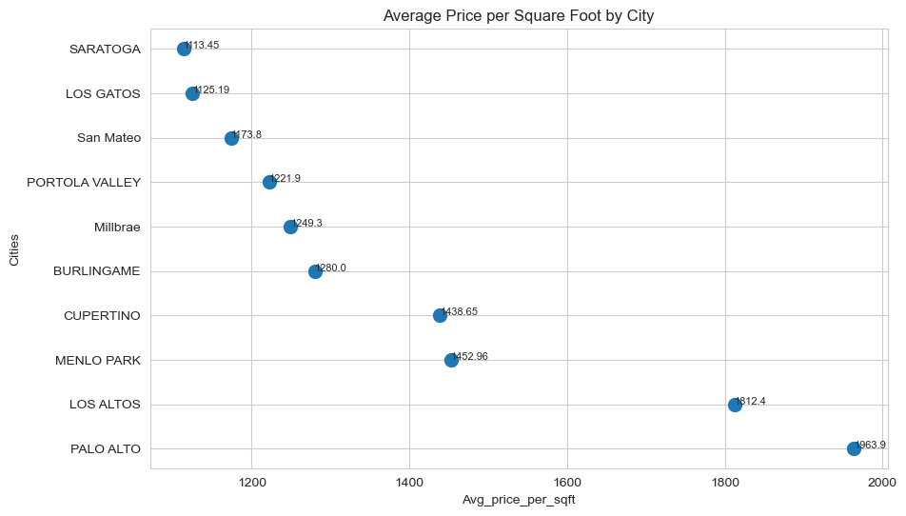
Average price per sq. ft by top 10 cities
Palo Alto is the costliest city for Housing with average sq. ft price of $1963.9, followed by Los Altos and Menlo park with $1812.4 and 1452.96 respectively.

Slide 15
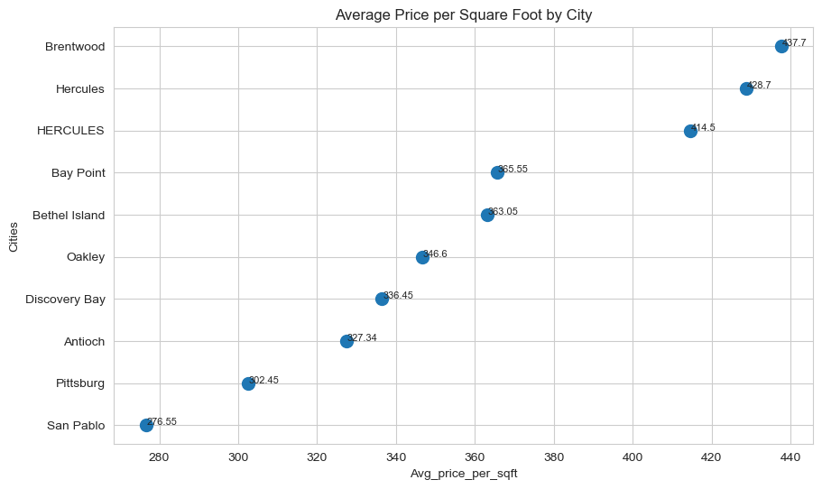
Average price per sq. ft by bottom 10 cities
San Pablo is the cheapest city for housing with average sq. ft price of $276.55, followed by Pittsburg and Antioch with $302.45 and 327.34 respectively.

Slide 16
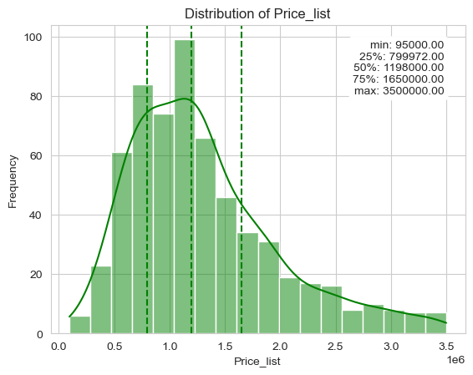
Distribution of price
The distribution of Price is right skewed which shows that there are outliers. i.e. Some houses have a very high price.

Slide 17
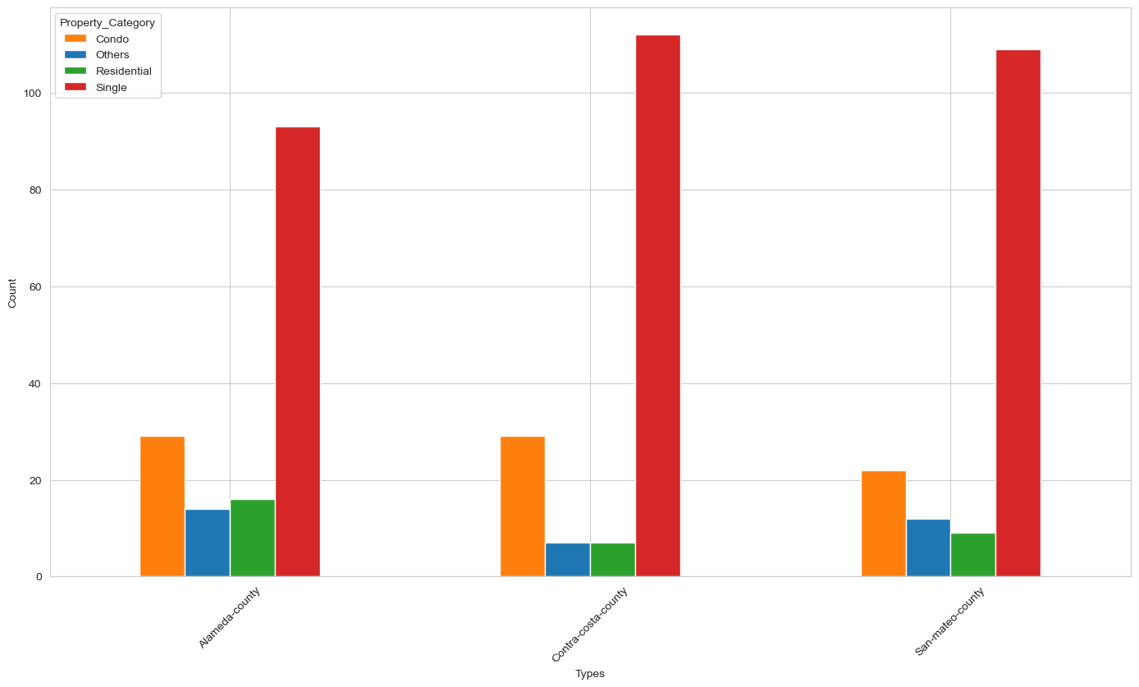
House Types based on Counties

Slide 18
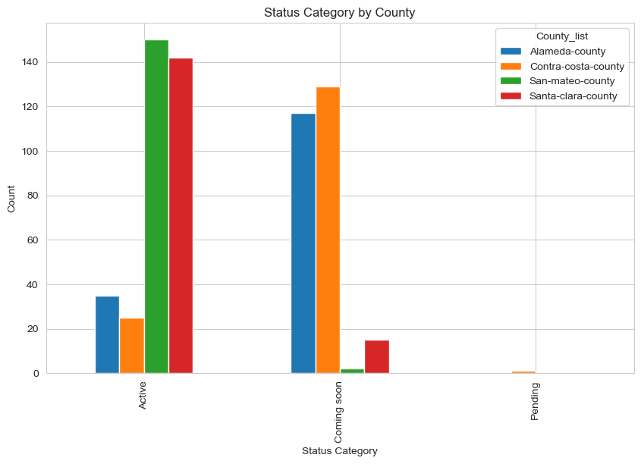
Status Category by County
San Mateo and Santa Clara Counties have most number of active houses.
Alameda and Contra Costa counties have most number of houses which will be active in future.

Slide 19
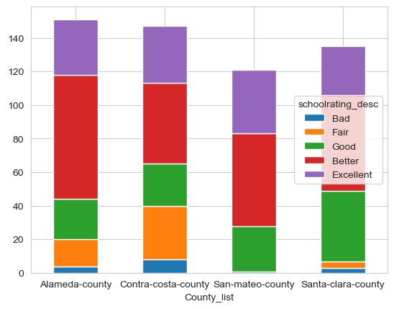
School rating by County
Alameda County has a highly rated as better.
Contra Costa County has a mixed rating of Fair and better.
San Mateo County is highly rated as better.
Similarly, Santa clara County is also rated as a mix of good and better.

Slide 20
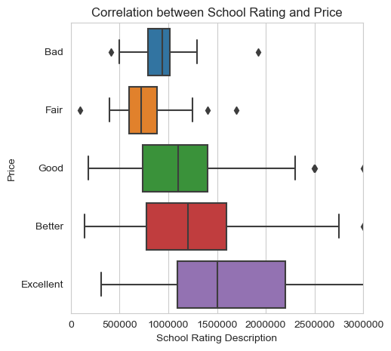
Relation between school rating and price
Price is strongly correlated to School rating.
Higher is the school rating, higher is the price of house.
Price doesn’t vary much when the school rating is lower.

Slide 21
Predictive Analysis

Slide 22
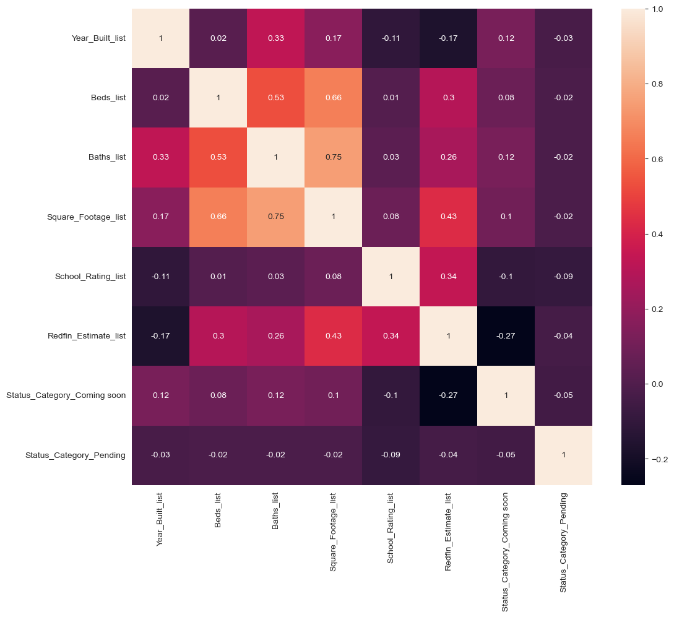
Correlation Heatmap
The correlation heatmap show a perfect positive correlation.So we can say the variables are highly correlated to each other.

Slide 23
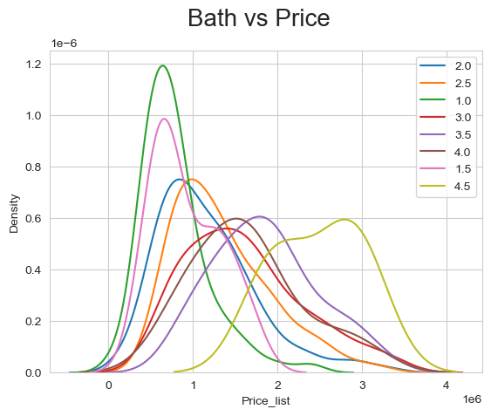
Distribution of Bath Vs price
The number of bathrooms increases, the price of the property tends to increase

Slide 24
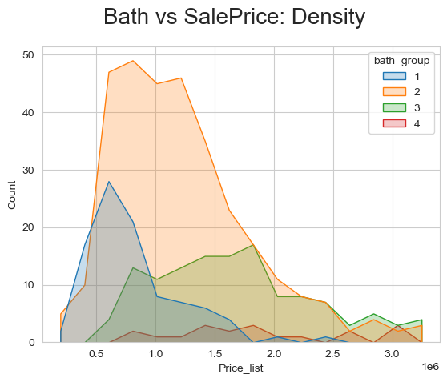
Distribution of Bath Vs Sale Price
The distribution of sale prices for properties with one or two bathrooms is relatively spread out, indicating that there is a wider range of sale prices for properties with fewer bathrooms.
The distribution of sale prices for properties with two or more bathrooms is relatively concentrated around the higher end of the sale price range, indicating that there is a narrower range of sale prices for properties with more bathrooms.

Slide 25
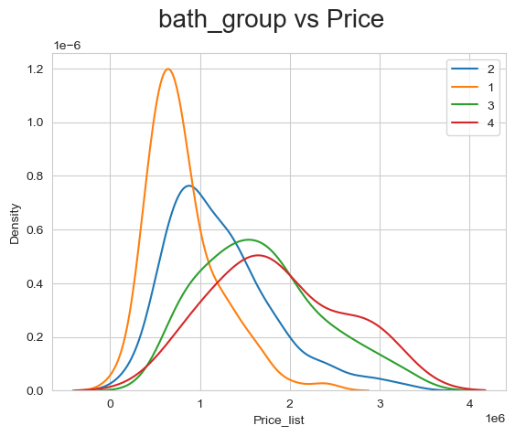
Distribution of Bath group Vs Price
As the number of bathrooms in a property increases, the price of the property also tends to increase

Slide 26
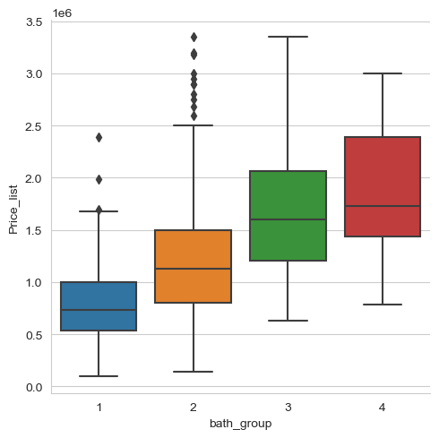
Boxplot of Bath group vs Price List
The median price for properties with one bathroom is lower than the median price for properties with two bathrooms, and the median price for properties with two bathrooms is lower than the median price for properties with three bathrooms, it suggests that there is a positive correlation

Slide 27
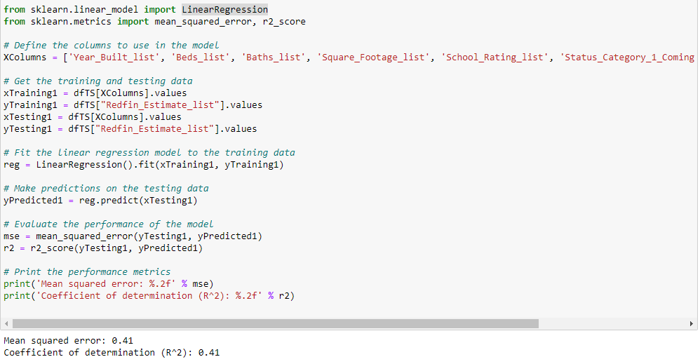
The Linear Regression model has an MSE of 0.41 and an R^2 of 0.41. This suggests that the model is not performing particularly well, as it has a relatively high error rate and the fit is not very good.

Slide 28
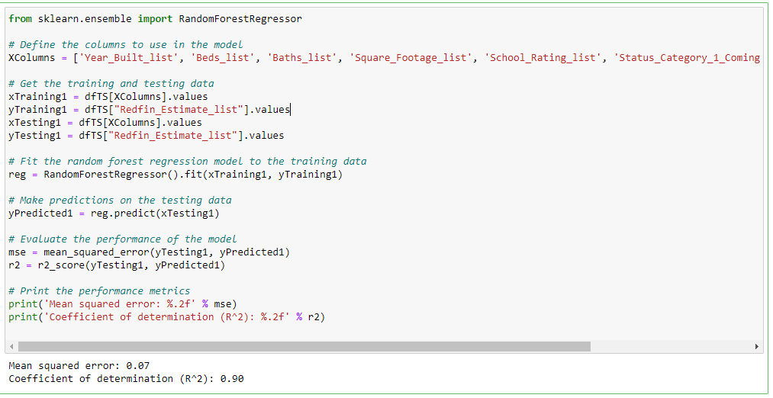
The Random Forest Regressor has an MSE of 0.07 and an R^2 of 0.90, which indicates that the model is performing much better than the Linear Regression model. The low MSE indicates that the model's predictions are much closer to the actual values, while the high R^2 suggests that the model is a good fit for the data.

Slide 29
Submitted By
Group 4:
Prachiti Sujit Jadhav
Sukhman Legha
Arun Sathiya Vaithiyam Ramasami
Abhinandan Somachetty
Sai Kumar Dyavathi

